Slide 1
AIMMS
WebUI demo
Notes:
Lettertype Header: Verdana / 42 pts / dark blue / All caps / Left aligned
Lettertype Subheader: Verdana / 20 pts / orange/ All caps / Left aligned

Slide 2

Typical AIMMS 3 Usage
Model Development
Model Execution
Model Optimization (solve)
End User View
All on a single (desktop) computer
AIMMS
Notes:
Lettertype Header: Verdana / 20 pt / dark blue / All caps / Left aligned
Lettertype Body: Verdana / 16 pt / dark grey / Left aligned / Bullets orange

Slide 3

Typical AIMMS PRO Usage
AIMMS
AIMMS
Model
Execution
AIMMS
publish
End User View
AIMMS
AIMMS
Model
Execution
Model Development
Model Optimization
End User View
SERVER
CLIENT
Notes:
Lettertype Header: Verdana / 20 pt / dark blue / All caps / Left aligned
Lettertype Body: Verdana / 16 pt / dark grey / Left aligned / Bullets orange

Slide 4

Typical AIMMS WebUI Usage
browser
AIMMS
Model Execution
AIMMS
publish
End User View
browser
AIMMS
Model Development
Model Optimization
End User View
SERVER
CLIENT
Notes:
Lettertype Header: Verdana / 20 pt / dark blue / All caps / Left aligned
Lettertype Body: Verdana / 16 pt / dark grey / Left aligned / Bullets orange

Slide 5


AIMMS WebUI Components
v
AIMMS
Application and widget code
Pages and widget database
v
v
v
CubeServer
WebUI Runtime
WidgetServer
WebUI
data
framework
UI
browser
Notes:
Lettertype Header: Verdana / 20 pt / dark blue / All caps / Left aligned
Lettertype Body: Verdana / 16 pt / dark grey / Left aligned / Bullets orange

Slide 6


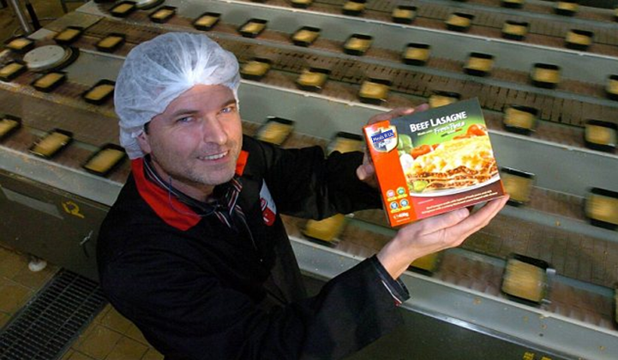
WebUI demo - Meet John @ Meals R Us
Scope
Daily planning of 4 weeks
3 production lines ^{beef/chicken/salmon}
20 meal types (demand, price)^{\day}
10 ingredients (supply, price)^{\day}
Stock option for meals produced
Needs to satisfy customer delivery SLA (%)
Notes:
Lettertype Header: Verdana / 20 pt / dark blue / All caps / Left aligned
Lettertype Body: Verdana / 16 pt / dark grey / Left aligned / Bullets orange

